Slide 1
Investigating Key Design Elements for an Artificial Pancreas Mobile Application Logan Clark, Chase Evans, Gabi Guadagnino, Emily Huffer, and Erin Murphey 2019 HFES Student Design Competition
Notes:
(Thank you for the introduction.) Again, I’m Logan Clark, and I’m a Ph.D. Student in the Department of Industrial Engineering at Clemson University.
The application I’ll be sharing with you today is the result of a semester of work with a team of undergraduate students in our department, as well as some more recent efforts to improve on our initial designs.
The focus of this work was designing effective displays to support the implementation of artificial pancreas systems for diabetes management.

Slide 2
Overview
Background
Diabetes
Design Challenge
Phase 1
Goals
Prototyping
Phase 2
Goals
Testing
Refinement
Prototyping
Future Work
Notes:
So for a quick overview of what I’ll be discussing today, I’d like to begin by sharing some background information regarding diabetes treatment methods and how they contribute to the specific design challenge that we chose to address.
From there, I’ll describe our first phase of design, which involved the development, testing, and refinement of a set of interactive prototypes, and then move on to discuss some more recent efforts to improve on the results of this first phase.

Slide 3
Diabetes: The Numbers (2015) ¹
30.3 million Americans diagnosed (9.4%)
1.5 million new diagnoses each year
7th leading cause of death
3.5 x
Notes:
So to give you a sense of the magnitude of the need that diabetes management technologies can address, the American Diabetes Association recently estimated that in the year 2015 more than 30.3 million Americans had been diagnosed with diabetes. People living with Diabetes account for almost 10% of the US population, or roughly 3.5 times the population of New York City, and this condition becomes more prevalent every year. Unfortunately, diabetes or complications resulting from it account for roughly 3.5% of deaths in the US, which makes this condition the 7th leading cause of death in the US. Some more recent estimates have placed this number even higher.

Slide 4
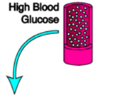
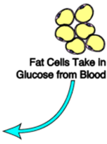
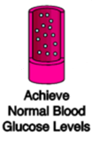
Managing Blood Glucose
Image: www.endocrineweb.com/conditions/diabetes
Notes:
To understand how we can go about treating this condition, it’s useful to have a general understanding of how the human body typically goes about controlling the amount of glucose in the bloodstream. If you’re like me before we began this project, you may not have needed to think too deeply about this process, since when it functions ideally it’s very efficient and doesn’t require any conscious management from us.
So when the average person eats a meal, the carbohydrates in food are converted to glucose and enter the bloodstream to be distributed to the cells. As the concentration of glucose in the blood rises, specialized cells in the pancreas detect this increase and release insulin into the bloodstream. The presence of insulin in the bloodstream makes it possible for glucose to be absorbed into fat cells to be stored or into muscle cells to be expended as energy. As glucose leaves the bloodstream and enters these other cells, the blood glucose level is reduced.
There’s a lot more to this process, and much of it is above my biomedical pay grade, but this is the core process that occurs to keep blood glucose within a safe range.

Slide 5
Type 1 Diabetes
Image: www.endocrineweb.com/conditions/diabetes
Notes:
However, for people with Type I diabetes, the pancreas is unable to secrete insulin in response to rising blood glucose levels. As a result, glucose levels can continue to rise unchecked, and glucose stays in the blood rather than reaching its appropriate destinations in muscle and fat cells. Over time, continued exposure to excessively high blood glucose levels can lead to serious complications and significantly decrease a person’s quality of life.

Slide 6
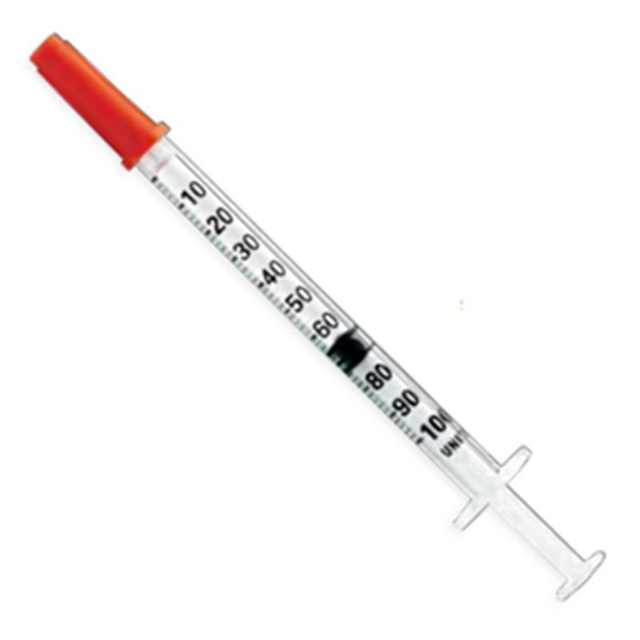
Treatment: Insulin Therapy
Insulin Injection
Notes:
The most common method of managing this condition is insulin therapy, which involves providing the body with injections of insulin throughout the day to simulate the normal activity of the pancreas as well as possible.
When these doses of insulin are sized and timed correctly, they can support the uptake of glucose into the appropriate cells and help to keep blood glucose levels within a safe range. This treatment approach has become a part of daily life for people who live with diabetes, so naturally there have been many attempts over the years to make this process as safe and as simple as possible for this growing group of people.

Slide 7
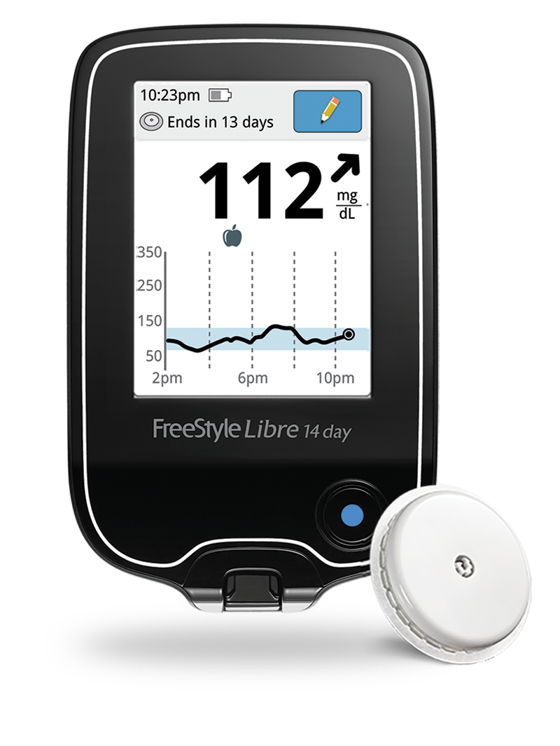
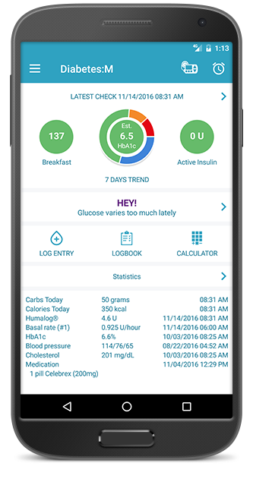
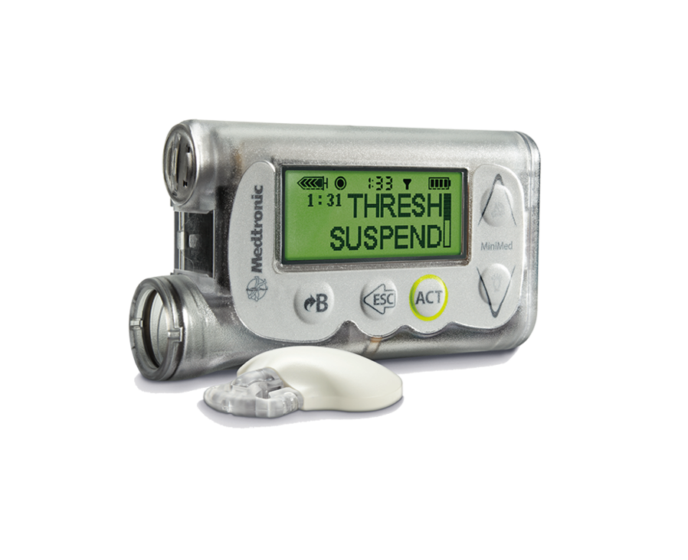
Insulin Therapy Methods
Initial Approach
Current Technology
Artificial Pancreas
Test:
Recall:
Calculate:
Inject:
Manual
Manual
Manual
Manual
CGM
CGM
Inform
Input
Control Algorithm
App
App
Display
Instruct
Pump
Pump
Notes:
In its earlier forms, insulin therapy required users to manually test their glucose levels several times each day by pricking their finger with a dedicated glucose meter.
Before eating a meal, users were also required to recall or estimate several parameters related to insulin sensitivity and to estimate the amount of insulin still active in their system based on the time since previous injections. Users would then feed these values into a formula to calculate the appropriate insulin dosage, and finally inject that dosage into their bloodstream.
In more recent years, technologies have emerged that allow users to offload some or all of these tasks to electronic aids. Finger pricks to test blood glucose can be replaced with continuous glucose monitoring devices that provide a detailed read-out of changes in glucose levels over time. In addition to this, the tasks of recalling key parameters and calculating the needed dose can be offloaded to dedicated tracking apps, which can store records of parameters and previous injections to ease to cognitive load placed on users. Finally, the task of injecting the amount of insulin they need can be offloaded to dedicated insulin pumps, which are always connected and prepared to deliver the appropriate dose.
All of these technologies have been useful for reducing demands on people who are living with diabetes. However, these subsystems all still require the user to act as a supervisory agent. They are still actively managing their blood glucose levels, but the process has been streamlined.
However, in the next few years this may not need to be the case, because systems are currently in development that offer the possibility of connecting all of these management devices into a single closed-loop system that could function independently of the user’s direct supervision. These are commonly called “artificial pancreas” systems. Although the potential configurations of these systems can vary, the general idea is to feed blood glucose readings from a continuous glucose monitor and parameters input by the user or their doctor into a control algorithm. With this information, the algorithm can automatically identify when insulin adjustments are needed and direct an infusion pump to inject the appropriate amount of insulin. Current glucose readings and actions taken by the system would be displayed to the user in a mobile app or the screen of the CGM.

Slide 8
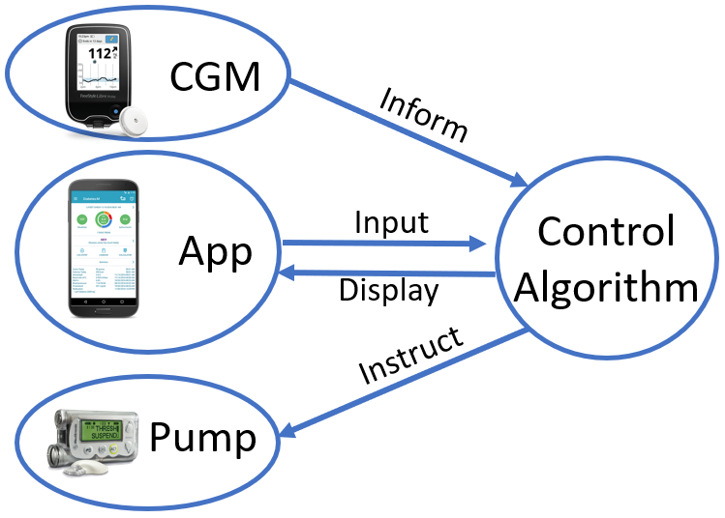
Challenge: Display Representation
Notes:
This technology could provide a promising opportunity to improve the quality of life for people living with diabetes. However, like all new technologies, it introduces a new set of potential challenges. While the details of system components and algorithm functionality are being worked out, we thought it could be valuable to consider how these future systems can best represent behaviors of the complex, interconnected subsystems through their displays. However effective the technology behind these systems may be, its behavior needs to be represented to users in a way that allows them to understand it and develop appropriate trust and reliance on its capabilities.
At the end of the day, manufacturers of this technology will be asking users to entrust their lives to this type of system. If the relationships and constraints that govern the system’s behavior are not clearly represented to the end user, we risk asking users to entrust their lives to a “black box”. I know that I certainly would not agree to this arrangement.
We set out to address this challenge by developing, testing, and iteratively refining a mobile display interface for a future artificial pancreas system.

Slide 9
Key Relationships to Represent
Measured Blood Glucose
Measured Blood Glucose
Raw Physiological Measures
User Input
Boundaries of Safety
Insulin Active in System
Exercise Detection
System Response
Notes:
Now in these future systems, it will be necessary to represent several key variables and relationships to the end user. These include the relationship between measured blood glucose and boundaries indicating safe levels and the relationship between glucose levels and the quantity of insulin currently active in the system. It will also be important to represent the contribution of various raw physiological measures for identifying when a user is engaged in exercise and adjusting system parameters accordingly, while also explicitly capturing the relationships between users’ input and patterns of system response.
While we sought to address all of these relationships in our display representations, for this presentation I am going to focus on describing our approach to representing glucose levels with respect to boundaries of safety and highlighting how our approach to tackling this problem has evolved over the course of the project through testing and iterative refinement.

Slide 10
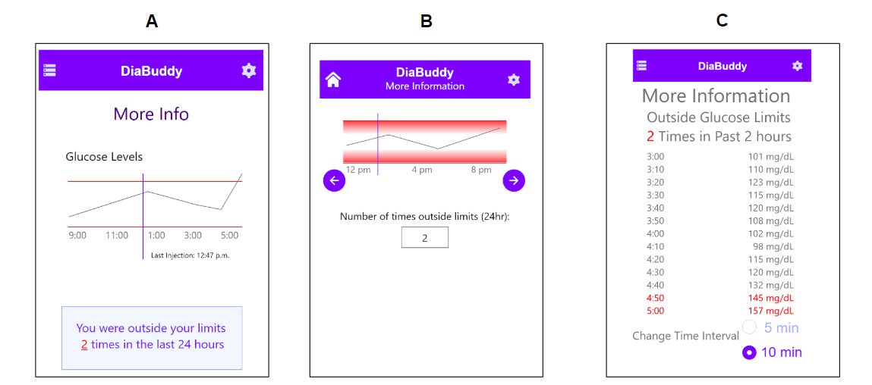
Design Phase 1: Prototyping and Testing
Question: How to represent status relative to boundaries?
Hard Boundary
Graphical
Gradient
Text
Notes:
With these goals defined, we performed some testing using three interactive prototypes to identify effective methods of achieving them in our display.
Most of our focus here was on the second goal of representing current status relative to boundaries. It has been established in the display design literature that textual displays are typically the most effective method for providing precise readouts of variable values, so we didn’t feel a need to investigate alternative means of addressing the first goal. However, we did include a textual readout of current glucose values in all 3 displays to identify whether this method was effective for supporting precise readouts of current glucose values
For the second goal of representing status relative to boundaries, we compared three potential methods of providing this information to the user. Based on what we know about display design, we suspected that graphical representations would convey this information more effectively than textual readouts of glucose values over time. However, since users have expressed a strong preference for having precise readouts of glucose values available, we decided to compare these two techniques empirically to figure out which one best represents status relative to boundaries in this context.
We also compared two types of graphical displays. In one of these displays we used simple hard boundaries to indicate when glucose levels were in or out of range, and in the other we added a textural gradient to the graph to signal approach to the boundaries. Including this element in a display might improve users’ ability to judge the extent of the safety risk introduced by the current glucose value as it approaches the boundaries. However, by blurring the boundaries between “safe” and “unsafe” conditions, this element might make it more difficult for a user to distinguish between conditions when the glucose level is actually unsafe and conditions when it is just approaching closer to the boundaries. For this comparison, we wanted to determine if including a texture gradient in a graph could introduce confusion regarding the in- or out-of-bounds state of the current glucose reading.
So to address these questions, we conduced a usability study with 6 university students. For this testing, we had participants use each interface to complete a set of tasks that we designed to assess our goals for each feature. For the blood glucose level display, these tasks were to find and report the current glucose level, and to determine if that level was safe using the representations provided in each interface. While the participants performed these tasks, we recorded their interactions with the display with screen-capturing software and reviewed the footage to code the completion time and accuracy for each task.

Slide 11
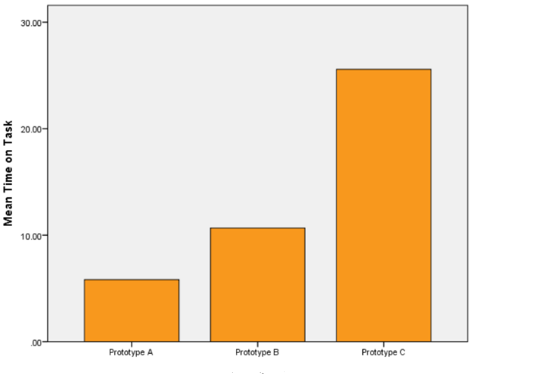
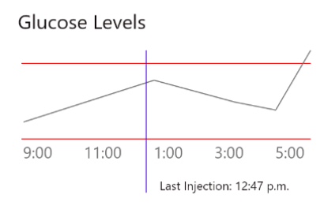
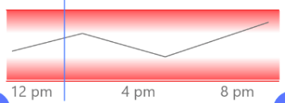
Results: Completion Time
Notes:
For the risk communication task, this is what our results looked like for completion time. Participants took longer to identify if the current state was in or out of safe boundaries when using the text based display than when using either of the graphical displays. This result confirmed our expectations and conforms to the conventional wisdom in display design. Based on these results, it appears that graphical displays will be more effective than textual readouts for supporting risk communication.

Slide 12
Results: Accuracy
Prototype A | Prototype B | Prototype C
6/6 | 1/6 | 5/6
Notes:
When we looked at accuracy, we saw that the graphical display that included a texture gradient did appear to create confusion regarding whether the current glucose value was safe or unsafe. 5 out of the 6 participants incorrectly identified a glucose value within the gradient as being outside of safe boundaries, while all 6 participants correctly identified values as being safe or unsafe when using prototype A.
In practice, this type of texture gradient may be useful to highlight approach to boundaries, if coming within a certain distance from a boundary results in meaningful costs to safety. However, when the task is to make a binary judgment of whether the current state is dangerous and requires action or if it is safe and requires no action, it appears that blurring the boundaries for this decision might be counterproductive.
In addition to these results, we also observed that all participants were able to accurately retrieve precise glucose values from textual readouts on the glucose display for all three interfaces. This confirmed the effectiveness of textual displays for conveying this information to the user.

Slide 13
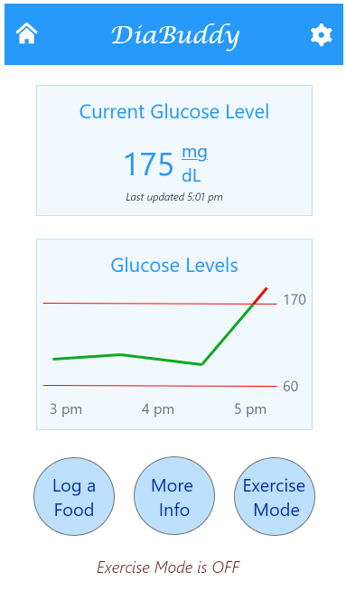
Design Phase 1: Refined Prototype
Notes:
Based on these results, we incorporated the elements that we found to be effective during testing into a refined interactive prototype display. The box at the top of the screen in this display provides a salient textual readout of the current glucose reading, along with an indication of the time when this level was recorded by the CGM.
Below the textual readout, a line graph spatially represents the location of the current glucose level relative to the boundaries of safe operation, and highlights deviations from these boundaries by changing the color of the line when it crosses over a boundary. The buttons at the bottom of the screen link to other display views that were designed to represent the other key relationships in this system.
These views were tailored to these other goals following a process similar to the one used in developing and testing this display.
By this point we had reached the end of the Fall semester, so we submitted this prototype as our entry in this competition.

Slide 14
Design Phase 2: New Considerations
Targets and safe boundaries can vary over time
Goal: Represent changes over time
User behaviors can influence variability in safe boundaries
Goal: Represent boundaries in the context of user behavior
Present state relative to boundaries not salient
Goal: Saliently represent current glucose reading and its relationship to boundaries
Notes:
In the time since we submitted the refined display, I’ve had a opportunity to work with a coach to further refine our initial designs. From talking with him, it became clear to me that we may not have developed a deep enough understanding of the complexities of the task domain to accurately represent this complexity in our interface. On his recommendation, I took a more detailed trip into the diabetes literature to identify any additional constraints that we might need to account for. I learned a few things through this process, and developed some new design goals based on what I found.
First, I learned that target values and boundaries of safe operation for blood glucose levels may vary over time due to metabolic patterns or other conditions in the user’s environment. Our simple line graph display with two constant boundary lines does not effectively capture these changing constraints, so I determined that adjustments would be needed to represent changes in these parameters over time.
Second, I learned that users’ daily behaviors can influence the values of target levels or safe glucose level boundaries. In particular, boundaries may adjust in the hours immediately following a meal. Additionally, I learned that eating meals and engaging in exercise can influence glucose activity. Consuming food can raise blood glucose when insufficient insulin is active in the user’s body, and physical exertion can increase insulin sensitivity, which ultimately lowers blood glucose levels. Our original interface did not provide a means of representing the influences of these events on current glucose levels and changes in safe operation boundaries, so I made it a goal to represent this context in the next iteration.
Third, after some more detailed exposure to the principles of display design, I noticed that the horizontal line graph in our prototype interface does not provide a salient representation of the current status relative to boundaries. In that interface, the user can identify the point on the line that corresponds to the present reading and then observe its location and trend relative to the boundaries. However, even though this point is considerably more important than the other points on the line because it indicates the present state of the system, it is no more salient than all of the other points.
In addition, the change in line color that we used to highlight deviation from safe boundaries may not increase the salience of these events for all users, particularly those with limited vision. Based on these limitations of the original interface, I made it a goal to incorporate a salient spatial representation of current glucose readings relative to critical boundaries in the next iteration.

Slide 15
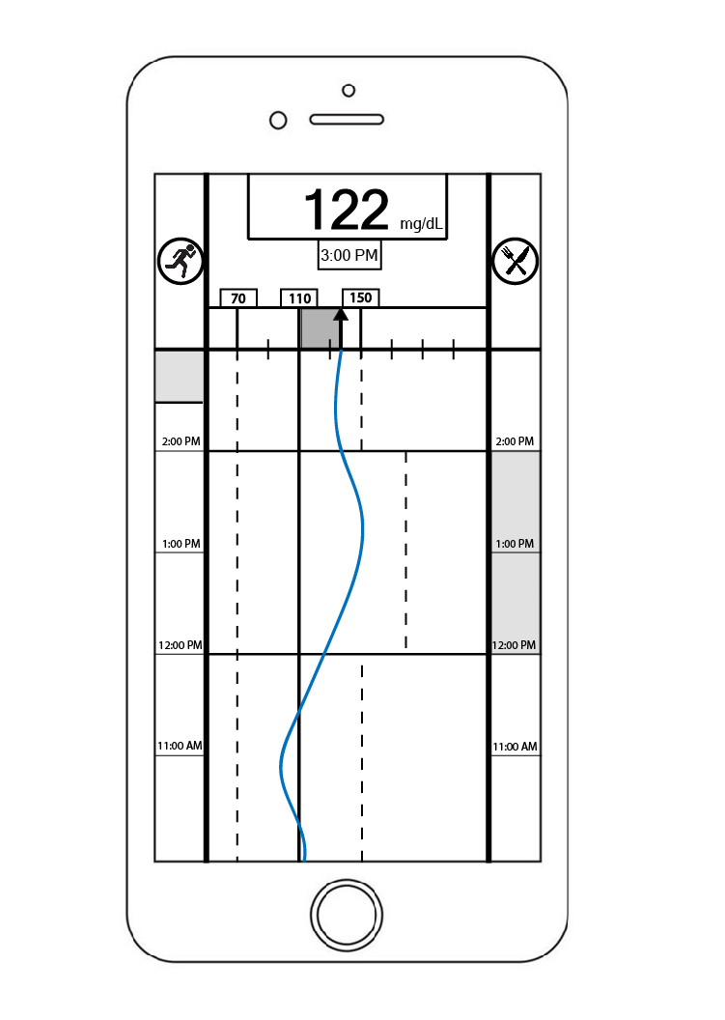
Design Phase 2: Static Prototype
Notes:
With these goals as a framework, I conducted an analysis of the task domain and developed a new static prototype interface that represents some of the more complex variable relationships I identified in my secondary research and makes important information salient to the user. This is what the display now looks like in its current form.
At the top of the screen, a textual display provides a precise readout of the current glucose value and the time at which it was measured. Directly below that, an analog pointer provides a spatial representation of the current glucose value relative to the boundaries of safe operation. As the pointer moves relative to the target glucose level, it sweeps out an area in the space above the axis. The size of this area corresponds directly to the degree of deviation from the target glucose level, and it is shaded in to provide a salient representation of the magnitude of current deviation from the target glucose level.
Below the pointer, a line graph display extends downward to indicate movement relative to target and safe operation boundaries at earlier points in time. Along either side of this portion of the display, dedicated timelines indicate when activity related to exercise and meals may be influencing glucose levels or safety boundaries. In this case, the user eats a meal at 12:00 PM, and the upper boundaries of their safe glucose levels shift upward for the following 2 hours. The beginning and end of this adjustment are indicated by lines that extend outward from the timeline into the graphical space. Settings related to the nature and durations of this type of adjustment could be adjusted to meet the needs of a particular user while incorporating this same display representation to indicate the onset and offset of changes in boundaries.
Right now, at 3:00, the glucose level in the display is within safe boundaries. When glucose levels exceed safe boundaries…

Slide 16
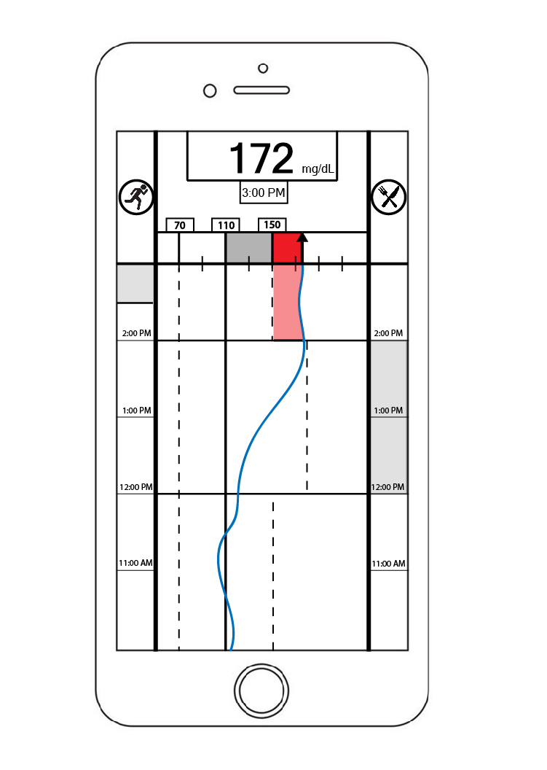
Design Phase 2: Static Prototype
Notes:
When glucose levels exceed safe boundaries, this representation highlights the presence and extent of the deviation by darkening and changing the color of the area swept out by the pointer in the space beyond the safety boundaries.
At the same time, it highlights the duration of the deviation looking back in time by darkening and shading in the area under the curve between the current level and safe action boundaries. This lets the user see at a glimpse how large of a deviation is currently occurring, how long it has been occurring for, and if the size of the deviation is increasing or decreasing relative to its magnitude in the past.

Slide 17
Design Phase 2: Static Prototype
Notes:
To the left and right of the textual glucose readout at the top of the screen, icons provide a shortcut to access dedicated meal and exercise announcement views. In this view, the user can also swipe up…

Slide 18
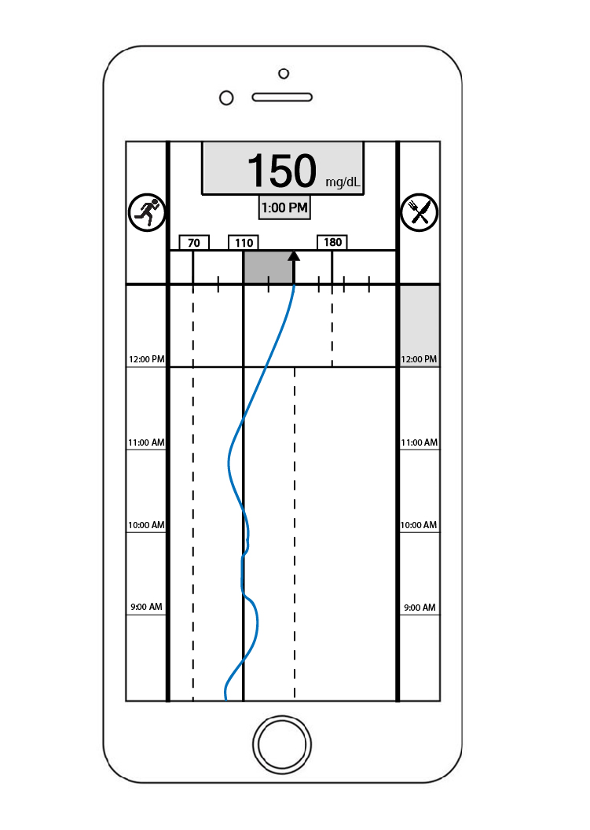
Design Phase 2: Static Prototype
Swipe
Swipe
Notes:
In this view, the user can also swipe up to scroll through time and view glucose readings from previous points in time.
As the user scrolls to a time point, the target and boundary values that were active at that time point slide into place at the top of the axis, and both the textual and analog displays of glucose level adjust dynamically to display the relevant values at the time point being viewed. In this case, the viewer scrolls back in time to view the glucose level measurements at 1:00 PM. At this time, the upper safety boundary was set to 180 rather than 150 mg/dL, so this value slides into place at the top of the axis.
To reduce the chance of users misinterpreting past values as current glucose readings, when the user is viewing data from previous points in time, the backgrounds of the glucose level and measurement time readouts are greyed out, and the point size of the text in the measurement time indicator is increased. Testing and discussion with users will be needed to determine if these measures are appropriate to avoid this type of confusion.

Slide 19
Design Phase 2: Static Prototype
Notes:
Finally, swiping to the left or right from this screen takes the user to similarly formatted views representing current levels of active insulin and the output of exercise detection algorithms. If you’re interested, I’d be happy to share my current paper prototypes for these views after the presentation.

Slide 20
Future Work
Domain Expert Consultation
Additional task constraints?
Accurate representation of task structure?
Testing with Users
Appropriate interactions?
Missing representations?
User behavior→ overlooked sources of regularity?
Notes:
As I mentioned, this design effort is still in progress, and there is quite a bit still to do to evaluate the next iteration of this display. Before continuing with any testing, I would like to consult with a domain expert to determine if there are any important task constraints that we failed to consider in the glucose level display or any of the other views. I would also like to hear their thoughts on how effectively these displays capture the underlying structure of the system that they represent. This newest iteration is based on my current understanding of the domain, so it is basically a hypothesis about how the domain is structured and can definitely be altered or improved by developing an even deeper understanding of the system.
After that, it would definitely be valuable to test this display with potential future users of AP systems. In particular, we will need to determine if the interactions with this system as they are currently designed appropriately map to users’ expectations and strategies.
I would also want to determine if there are relationships that expert users tend to capitalize on that are not explicitly represented in the current display. Identifying these and incorporating them into the display could significantly improve the effectiveness of the display for both expert and novice users.
Finally, it would be useful to observe users of current diabetes management technology as they go about their daily routines with currently-available glucose management aids. There may be some additional sources of regularity stemming from users’ behaviors that I have overlooked in the current design, and I would like to account for these and incorporate them into the representation.

Slide 21
Thank You for Your Attention
Notes:
So that’s all I have for today. Thank you for your attention, and I would be happy to take any questions.

Slide 22
Appendix

Slide 23
Future Work: Functional
Individual Differences
Represent influence on system behavior
Predictive display?
Represent anticipated effects of system behaviors
Alerts
Timing, modality etc.

Slide 24
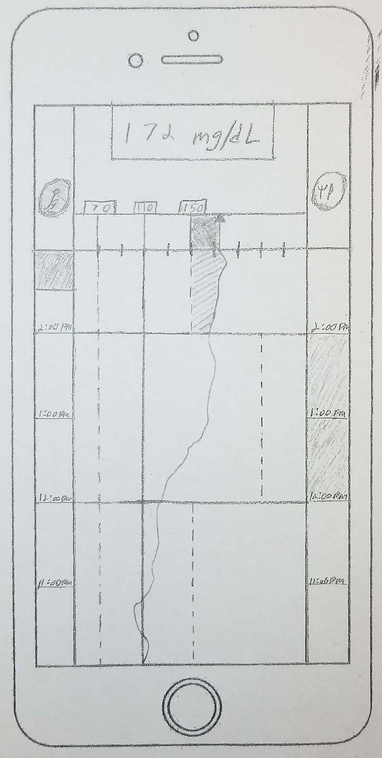
Current Prototype
Challenge: Contextualizing BG Measurements
High BG + sufficient active insulin ➔ BG will decrease soon
High BG + insufficient active insulin ➔ action needed
Notes:
As valuable and necessary as these blood glucose readings are, the readings alone (and out-of-range indicators) are divorced from the context of system behavior. Specifically:

Slide 25
Current Prototype
Challenge: Contextualizing BG Measurements
Possible approach: Display BG on the same scale as TAI
CF: Expected reduction in BG per 1 unit of active insulin
BG_{C}: Current BG level
BG_{T}: Target BG level
$$Displayed BG= \frac{BGC−BGT}{CF}$$
→
Estimated insulin needed
to return to target BG level

Slide 26
Current Prototype
Challenge: Contextualizing BG Measurements
Possible approach: Display BG on the same scale as TAI
CF = 30
BG_{C} = 172
BG_{T} = 110
$$Displayed BG= \frac{172−110}{30}$$
→
2.07 U needed to return to target
Notes:
Display BG on the same scale as active insulin (as estimated 2.07 units needed to return to the target), and facilitate comparison between this value and the current active insulin. (See if there is enough insulin active to meet this demand.

Slide 27
Current Prototype
Challenge: Contextualizing BG Measurements
Possible approach: Display BG on the same scale as TAI
Active Insulin (U)
TAI
Displayed BG
Time

Slide 28
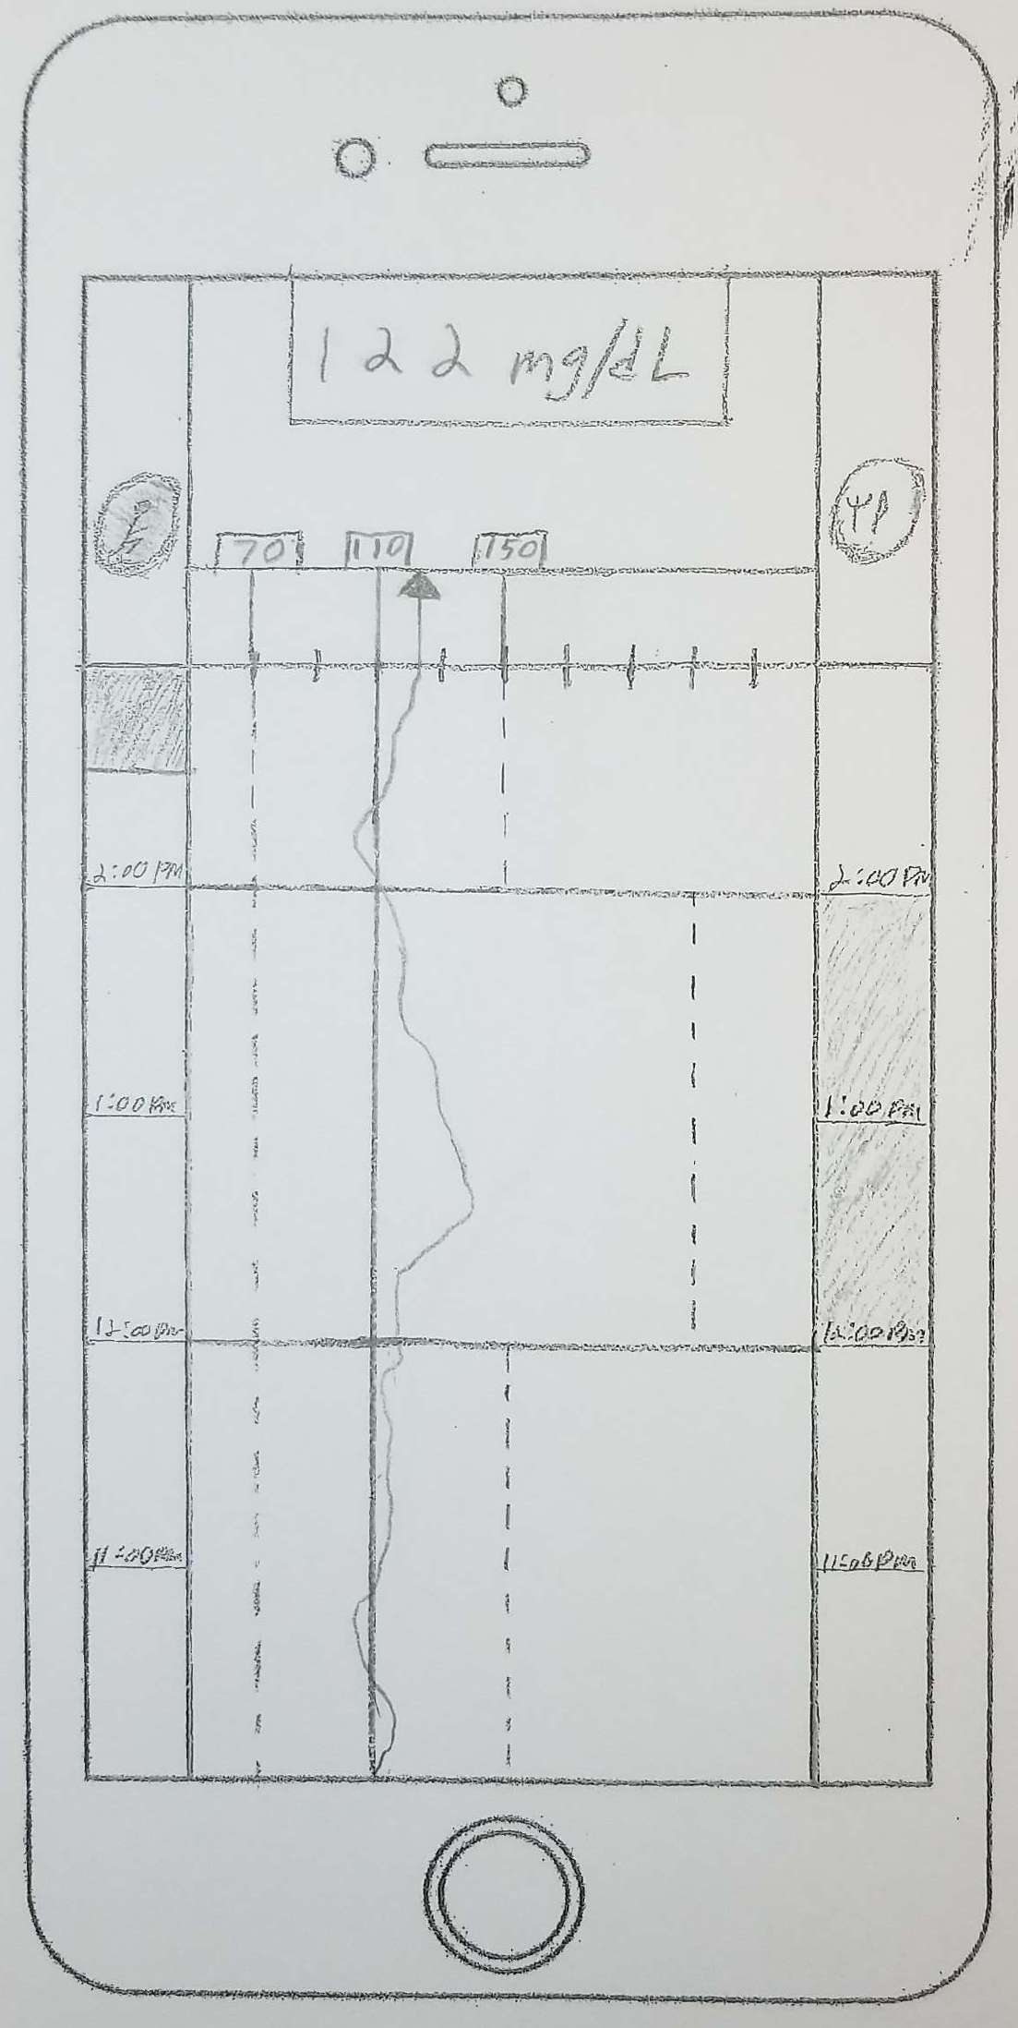
Current Prototype
View 2: Total Active Insulin (TAI)
Swipe

Slide 29
Current Prototype
View 2: Total Active Insulin (TAI)
Display BG levels in the context of current system state (TAI)
Textual readouts for key variables
Notes:
BG (mg/dL) axis scaled to map onto the TAI (U) axis using the current value of CF

Slide 30
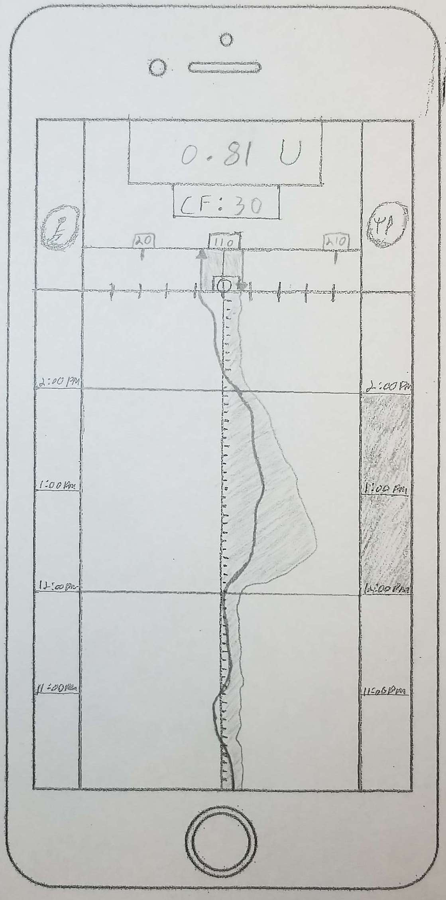
Current Prototype
View 2: Total Active Insulin (TAI)
Highlight mismatch between current BG and system response
1. Presence
2. Nature
3. Duration

Slide 31
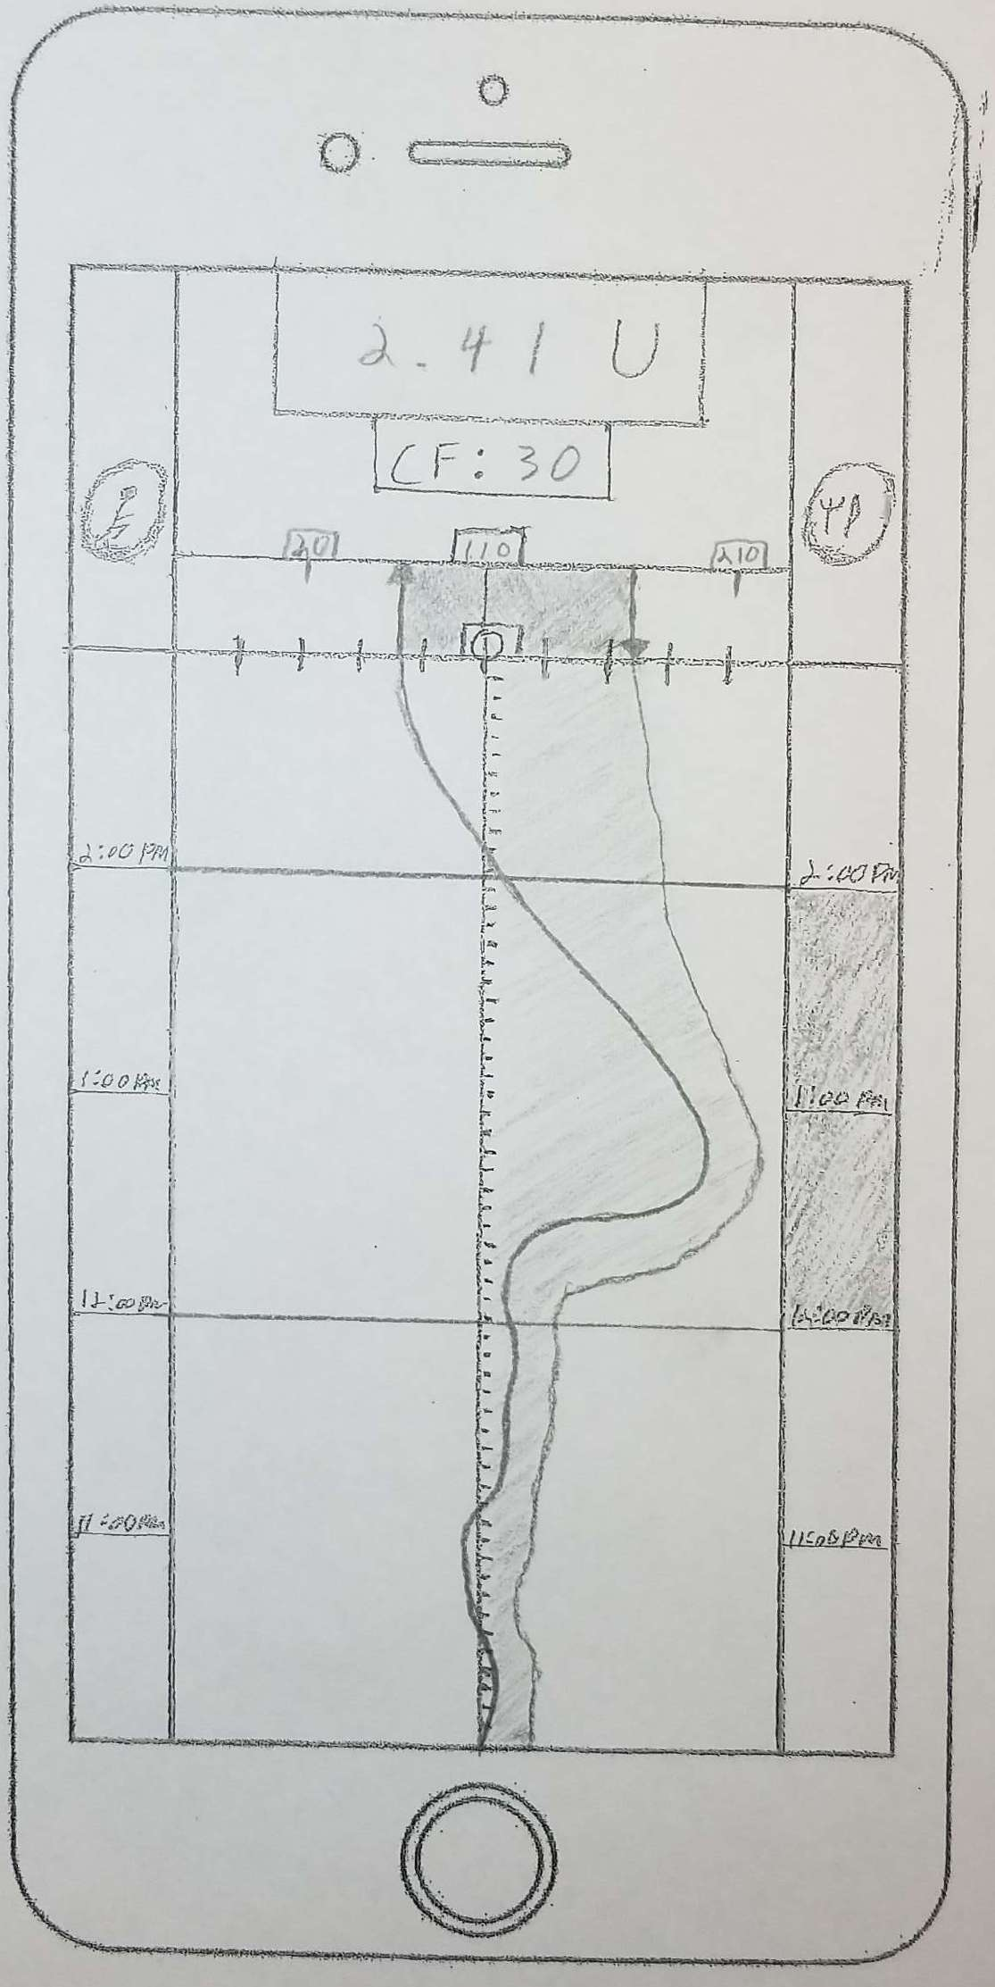
Current Prototype
View 2: Total Active Insulin (TAI)
Highlight mismatch between demands and system response
1. Presence
2. Nature
3. Duration
4. Magnitude

Slide 32
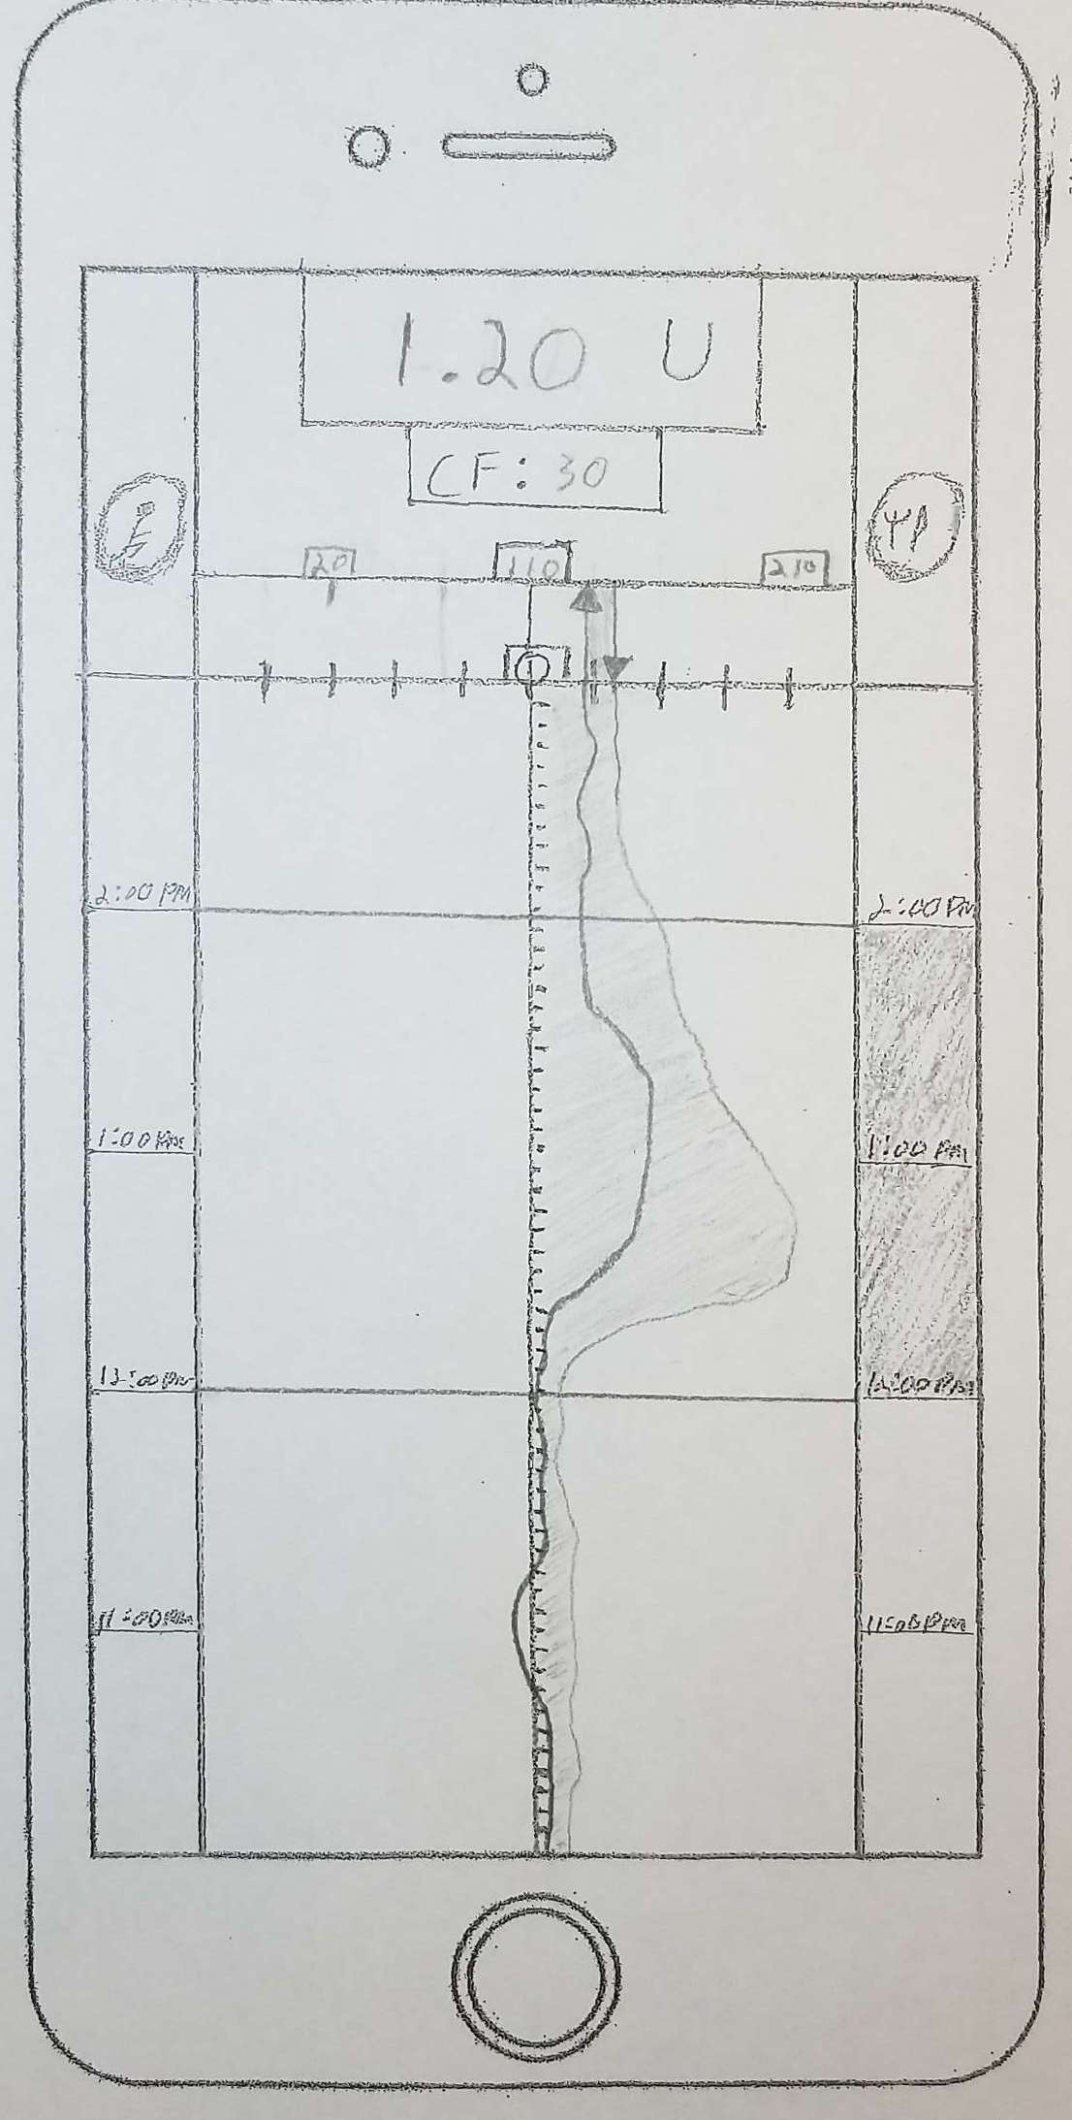
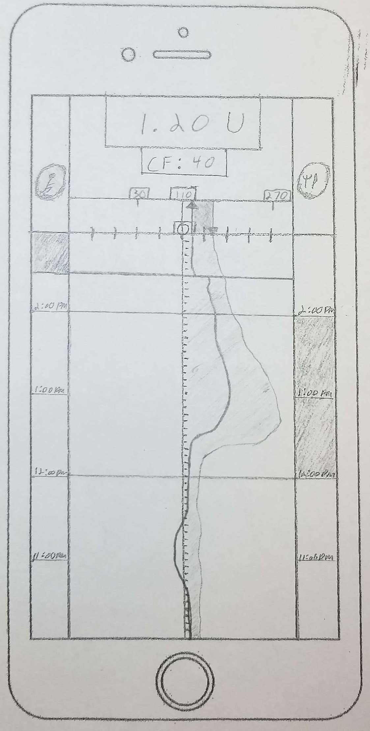
Current Prototype
View 2: Total Active Insulin (TAI)
Highlight how exercise changes relationship between BG demands and system response

Slide 33
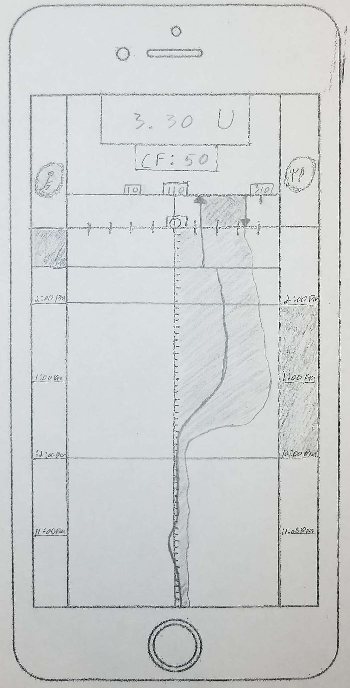
Current Prototype
View 2: Total Active Insulin (TAI)
Highlight how exercise changes relationship between BG demands and system response

Slide 34
Current Prototype
View 3: Exercise Detection
Swipe
Swipe

Slide 35
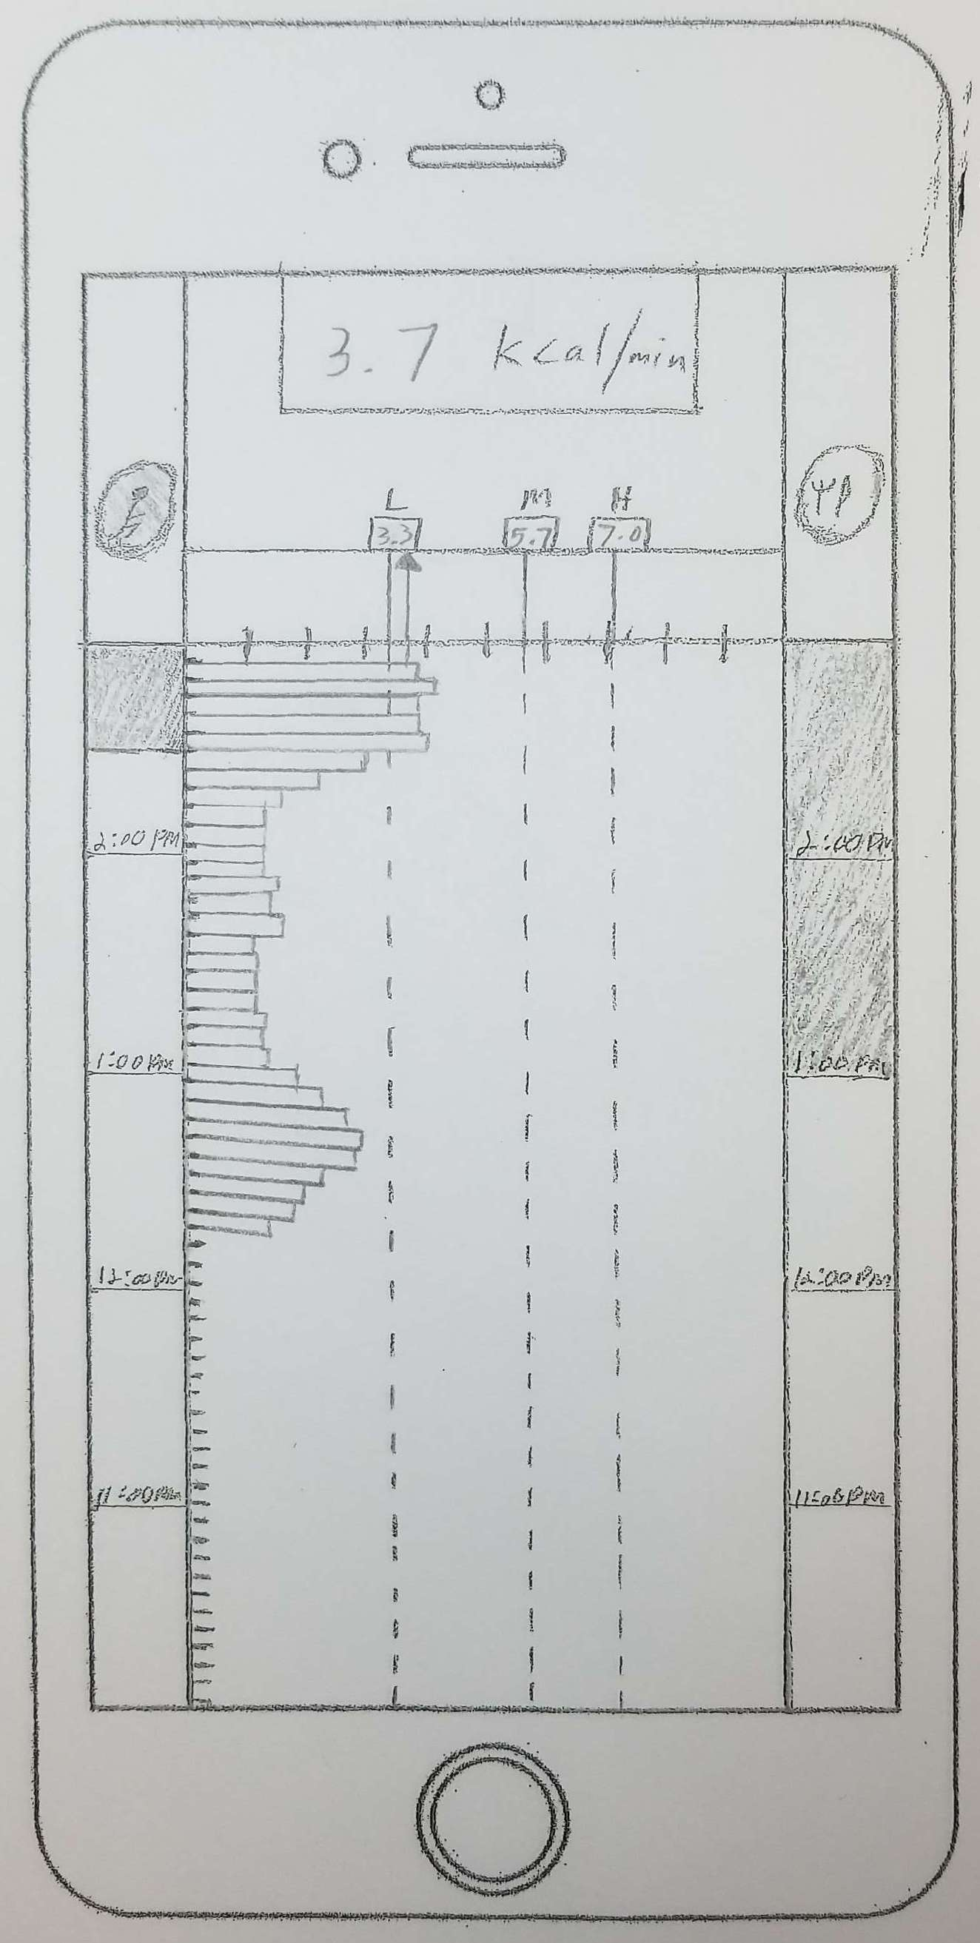
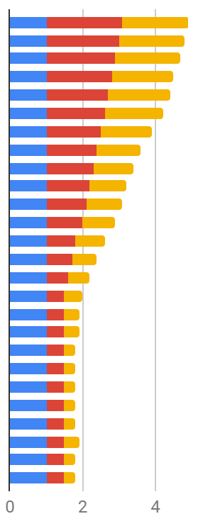
Current Prototype
View 3: Exercise Detection
U
HR
PA
For detection threshold crossing, represent:
Presence
Nature
Duration
Magnitude
Contributing Measures
User Variables (U)
Heart Rate (HR)
Physical Activity (PA)
Notes:
For this system element, key relationship is between estimated effort (in kcal/min) and boundaries that correspond to different intensities of exercise. Depending on the intensity of exercise, the system will need to adjust parameters differently.
Get a sense of how each sensor measure is contributing to the estimated effort calculation→ detect if sensor is giving incorrect readings/locus of physical behavior that triggered exercise detection.

Slide 36
Current Prototype
View 4: Input/Planning
Swipe
Swipe

Slide 37
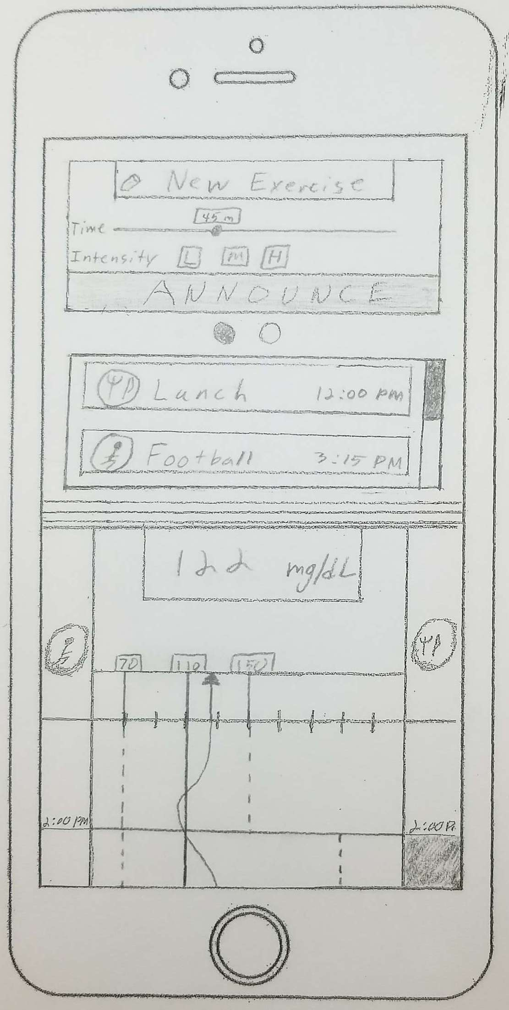
Current Prototype
View 4: Input/Planning
Basic exercise input using default settings
View and edit scheduled events
Continued access to data from other views
Swipe

Slide 38
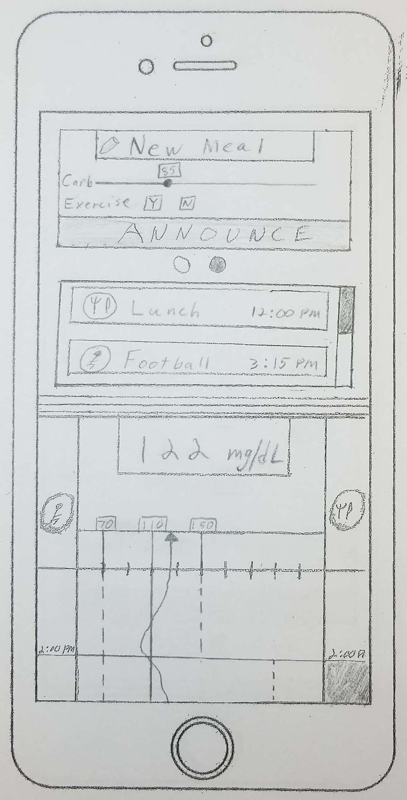
Current Prototype
View 4: Input/Planning
Basic meal announcement using default settings
Swipe

Slide 39
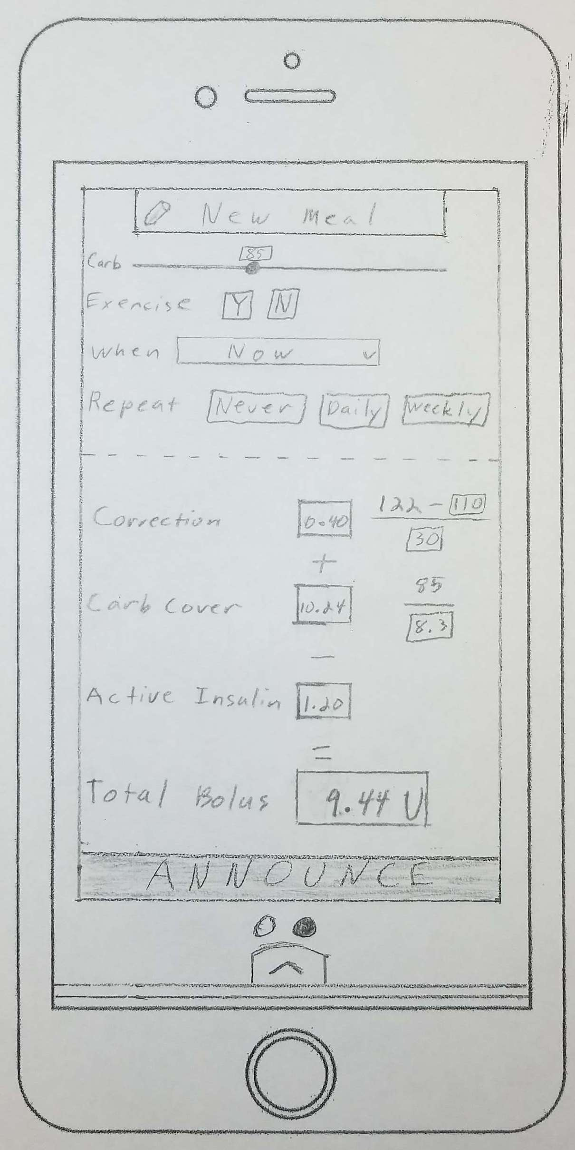
Current Prototype
View 5: Detailed Input
Basic meal variable input
Schedule repeat events
View process and parameters used to act on announcement
Notes:
Plan for similar detailed view for exercise and full screen view to view and edit planned events, but specific interface layout for these views not yet on paper.

Slide 40
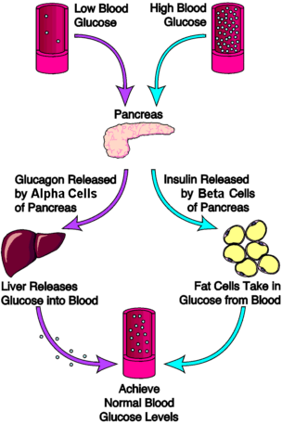
Type 2 Diabetes
Image: www.endocrineweb.com/conditions/diabetes

